Slide 1
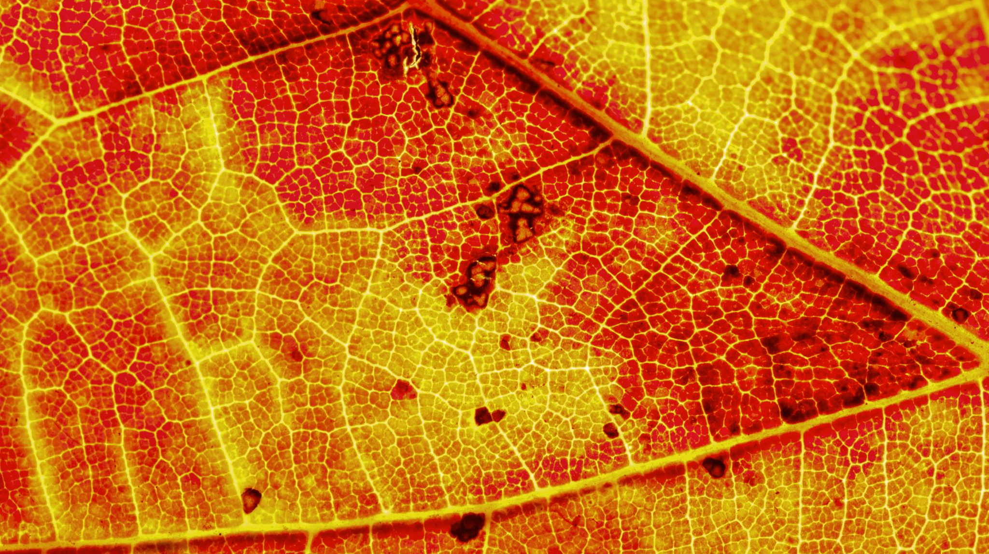
Polarity and Intermolecular Forces

Slide 2
Objectives
Identify polarity in covalent molecules
1
Distinguish between the intermolecular forces; dispersion forces, dipole-dipole forces, hydrogen bonds and ion-dipole forces
2
Relate the strength of the intermolecular forces to properties of covalent molecules including solubility, vapour pressure and melting/boiling points.
3

Slide 3
Polarity
Refer to, and take notes from, Pearson pages 270-273.
Electronegativity determines the the electron distribution of a bonding pair of electrons in a bond.
Molecules with an imbalance of electron distribution in its bonds are polar and those with an equal distribution of electrons in a bond are called non-polar.
For simplicity, you can ask yourself: does one side of this molecule have more electrons than the other? If so then there is an uneven distribution of electrons, and therefore a polar molecule.

Slide 4
Non-Polar molecules
Non-polar molecules have an even distribution in bonding and non-bonding electrons. Thus, molecules are generally symmetrical.
Examples of non-polar molecules are elemental diatomic molecules, e.g. H₂, O₂, N₂, Cl₂ etc.
https://courses.lumenlearning.com/suny-orgbiochemistry/chapter/4-4-characteristics-of-covalent-bonds/

Slide 5
Polar molecules
Polar molecules are those with an uneven distribution of electrons in the molecule.
This generally occurs when molecules are made up of different elements, as elements have different electronegativities and thus, attract electron density differently to their nuclei.
Examples include, HF, HCl, CO, H₂O

Slide 6
Non-polar vs polar molecules
Some molecules contain different elements but are non-polar if the distribution of electrons remains to be even. This occurs in symmetrical molecules (use VSEPR).
Examples include; CO₂, BH₃, CCl₄.
Hint: draw the Lewis structure of these molecules to show their even distribution of valence electrons.

Slide 7
Non-polar vs polar
Generally (for this Year 11 course), molecules with a lone pair of electrons are non-polar.
These lone pairs of electrons provide a partial negative (𝛿-) charge which are not evenly distributed.
Examples include; H₂O, SO₂, NH₃.

Slide 8
Pop Quiz – special sulfur edition
Draw the Lewis structure and determine whether the following molecules are polar or non-polar.
Hint: Annotate the 𝛿+ and 𝛿- regions of the molecule.
H₂S
CS₂
S₂
H₂SO₄

Slide 9
Pop Quiz – special sulfur edition
Draw the Lewis structure and determine whether the following molecules are polar or non-polar.
Hint: Annotate the 𝛿+ and 𝛿- regions of the molecule.
H₂S polar (lone pairs)
CS₂ non-polar (linear)
S₂ non-polar (linear)
H₂SO₄ polar (uneven distribution of atoms)

Slide 10
Polarity Questions
Pearson page 274
Lucarelli Set 24
STAWA Set 18

Slide 11
Intramolecular bonds vs intermolecular forces
Refer to, and take notes from, Pearson pages 275-279.
Intramolecular bonds include ionic bonds, metallic bonds and covalent bonds. These are very strong interactions of a bonding pair of electrons with atomic nuclei.
Intermolecular forces are weaker interactions between individual molecules.

Slide 12
Intermolecular Forces
There are three main types of intermolecular forces:
Dispersion Forces
Dipole-dipole forces
Hydrogen bonds
**Ion-dipole forces**

Slide 13
Intermolecular forces cheat sheet
Generally the strength of forces is as follows:
Ion-dipole > H-bonds > dipole-dipole > dispersion forces
All molecules have dispersion forces.
Intermolecular forces are weaker than intramolecular bonds.

Slide 14
Dipole-dipole forces
Polar molecules can attract each other by the electrostatic attraction of 𝛿+ and 𝛿- regions of their molecules.
https://www.khanacademy.org/test-prep/mcat/chemical-processes/covalent-bonds/a/intramolecular-and-intermolecular-forces

Slide 15
Hydrogen bonding
Hydrogen bonds are very strong dipole-dipole interactions between H-NOF.
That is a 𝛿+ H atom interaction with a 𝛿- N, O or F atoms. Note: generally this N, O, or F should also be bonded to a H atom.
The reason this interaction is classed separate to dipole-dipole forces is because of the large electronegativity difference between H and NOF atoms.

Slide 16
Hydrogen bonding in water
https://en.wikipedia.org/wiki/Hydrogen_bond

Slide 17
Dispersion forces
All molecules have dispersion forces; however, this is the only intermolecular force present in non-polar molecules.
https://www.khanacademy.org/test-prep/mcat/chemical-processes/covalent-bonds/a/intramolecular-and-intermolecular-forces

Slide 18
Dispersion Forces
Recall our knowledge of electrons. They are constantly moving within their orbitals and within the bonding orbitals.
Therefore, at any moment in time there could be an instantaneous uneven distribution of electrons.
This momentary uneven distribution can give rise to a temporary dipole, which can influence another molecule’s electron distribution creating an induced dipole.
This provides a weak temporary interaction called a dispersion force.

Slide 19
Induced dipoles
https://www.crediblehulk.org/index.php/2018/12/30/van-der-waals-london-dispersion-forces/

Slide 20
Dispersion forces
All molecules are capable of temporary dipoles and therefore all molecules have dispersion forces.
Larger molecules have stronger dispersion forces than smaller molecules.
This is due to the larger temporary dipole that is able to exist in molecules with more electrons.
Example; decane (C₁₀H₂₂) has stronger dispersion forces than ethane (C₂H₆).

Slide 21
Comparison of interactions
Strength intermolecular interactions:
H-bonds > dipole-dipole > dispersion
The stronger the interaction of molecules (intermolecular forces), the more energy will be required to break those interactions.

Slide 22
Properties of covalent molecules
Melting/Boiling point: The stronger the IMFs, the higher the m.p./b.p.
Vapour Pressure: the stronger the IMFs, the lower the vapour pressure.
Vapour pressure indicates the amount of molecules evaporating from the surface of a liquid. This evaporation requires less energy with weaker IMFs.

Slide 23
Solubility in water
Water contains strong hydrogen bonding between molecules.
These interactions give rise to a relatively high melting and boiling point (for a covalent molecule).
For a substance to dissolve in water, it must overcome the intermolecular forces present in the water molecules.

Slide 24
Solubility in water
That is to say, if a substance dissolves in water, it must break the intermolecular forces between water and create intermolecular forces between itself and water.
Therefore, generally polar molecules / ionic compounds can dissolve in water, as they can overcome the hydrogen bonds between water molecules and form their own hydrogen bonds or dipole-dipole forces with water molecules.

Slide 25
**ion-dipole forces*
When an ionic compound dissolves in water, very strong ion-dipole interactions can form. These are stronger than hydrogen-bonds, and is the interaction occurring when ions dissolve in water.
Formal positively charged cations interact with the 𝛿- region of the oxygen atom in water while formally negatively charged anions interact with 𝛿+ region on the H atoms in water.

Slide 26
https://www.ck12.org/book/ck-12-chemistry---basic/section/9.4/

Slide 27
“like dissolves like”
Generally, non-polar species do not dissolve in water they dissolve in non-polar solvents as they can overcome the weaker dispersion forces.
“like dissolves like”: please do not write this phrase to describe solubility. However, it is a useful phrase to help you remember that polar solutes dissolve in polar sovents and non-polar solutes dissolve in non-polar solvents.

Slide 28
The unique properties of water
Please refer to, and take notes from, Lucarelli page 133.

Slide 29
Absolute classic #21 – special isolation edition
Identify the IMFs present and account for the difference in boiling points:
Cl₂ BP = -35 C AND N₂ BP = -196 C
Ethane BP = -89 C AND Decane BP = 174 C
HCl BP = -85 C AND H₂O BP = 100 C

Slide 30
Absolute classic #21 – special isolation edition
Identify the IMFs present and account for the difference in boiling points:
Cl₂ BP = -35 C AND N₂ BP = -196 C
Both have dispersion forces. Cl₂ is larger, thus stronger dispersion forces.
Ethane BP = -89 C AND Decane BP = 174 C
Both have dispersion forces. Decane is larger, thus stronger dispersion forces.
HCl BP = -85 C AND H₂O BP = 100 C
HCl has dipole-dipole as its strongest IMF. H₂O has H-bonds as its strongest IMF. Thus, H2O has stronger interactions and more energy required to boil.

Slide 31
Questions
Pearson pages 280-281
Lucarelli Set 25
STAWA Set 19

